Slide 1


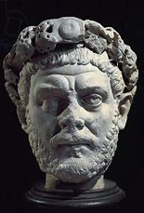
DIOCLETIAN
The Diocletian real name is CAESAR GAIUS AURELIUS VALERIUS DIOCLETIANUS.

Slide 2
LIFE
Diocletian was born in December 244 AD
In Salona(today Solin)and died in Salona 316 AD.
His nickname is Jovius. He has got wife Prisca and 3 childrens:Maximilian,Galerius and Valeria.

Slide 3
His look
Based on sculptures. He was tall and thin, with large forehead,a short,strong nose, a hard mouth, and a determined chin.

Slide 4
Emperor
Diocletian was roman emperor from 284 to 305 AD. After the defeat and death of the roman emperor philip the arab.

Slide 5
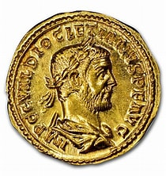
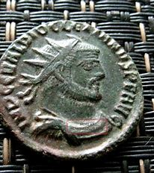
HE WAS ON GOLD COIN TO.
Because of his sick,he unfortunately died at age 71.

Slide 6

By: rita blažek 5.a
10.11.2023god

